Slide 1
My Fantasy Cricket
By :- Parmesh Joshi

Slide 2
Introduction
I have chosen this topic because I love playing cricket and that’s why I choose this
I'm very comfortable to do this project on this topic , I pretty exciting on doing this topic

Slide 3

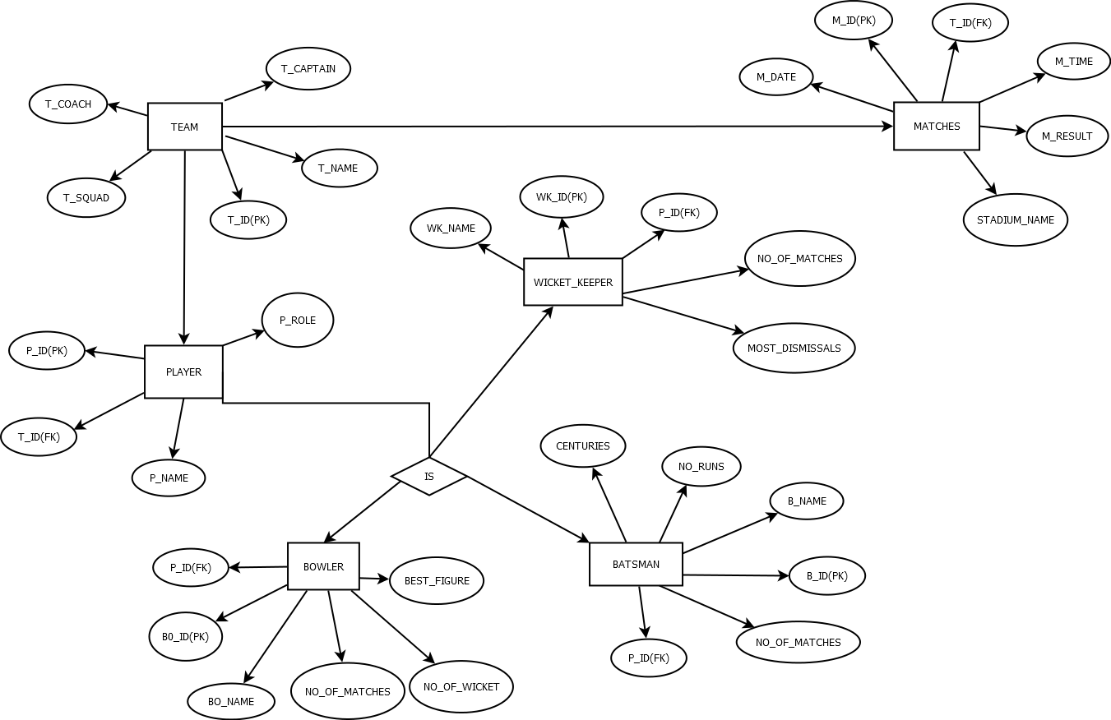
ER Diagram

Slide 4
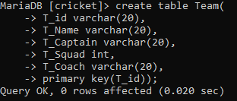
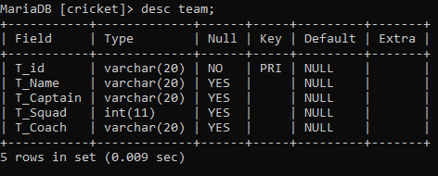
CREATE & DESCRIBE TABLE
TEAM

Slide 5
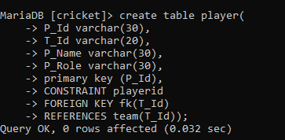
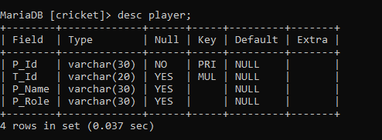
CREATE & DESCRIBE TABLE
PLAYERS

Slide 6
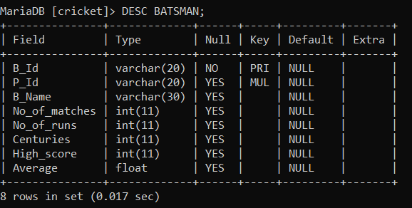
CREATE & DESCRIBE TABLE
BATSMAN

Slide 7
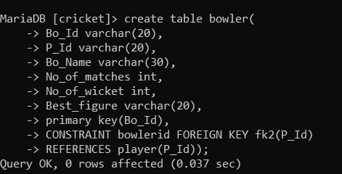
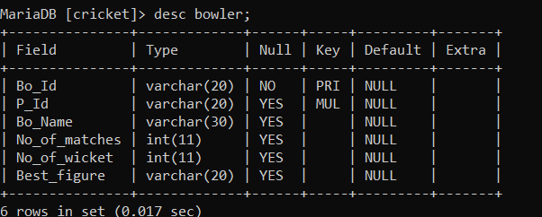
CREATE & DESCRIBE TABLE
BOWLER

Slide 8
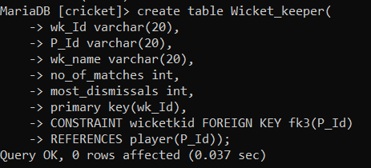
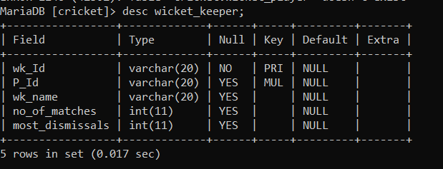
CREATE & DESCRIBE TABLE
WICKETKEEPER

Slide 9
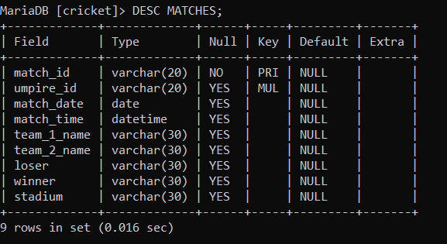
CREATE & DESCRIBE TABLE
MATCHES

Slide 10
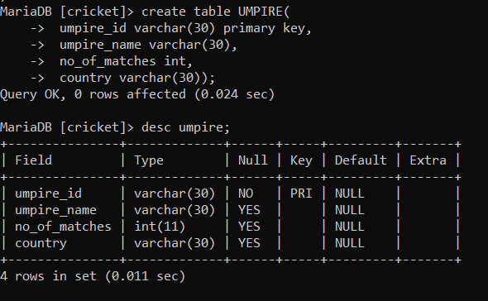
CREATE & DESC TABLE
UMPIRE

Slide 11
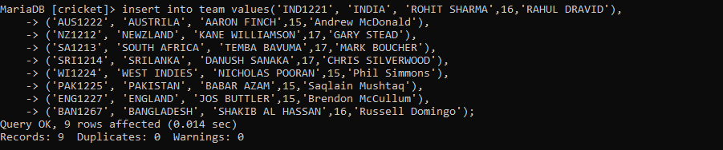
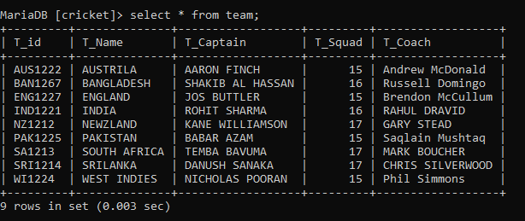
INSERT TABLE
TEAM

Slide 12
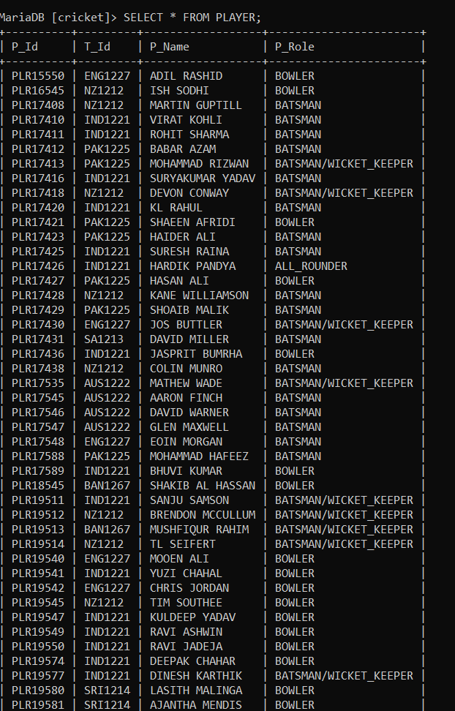
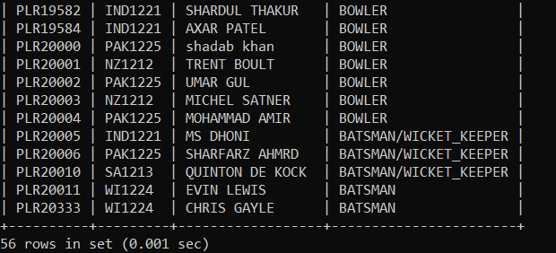
INSERT TABLE
PLAYERS

Slide 13
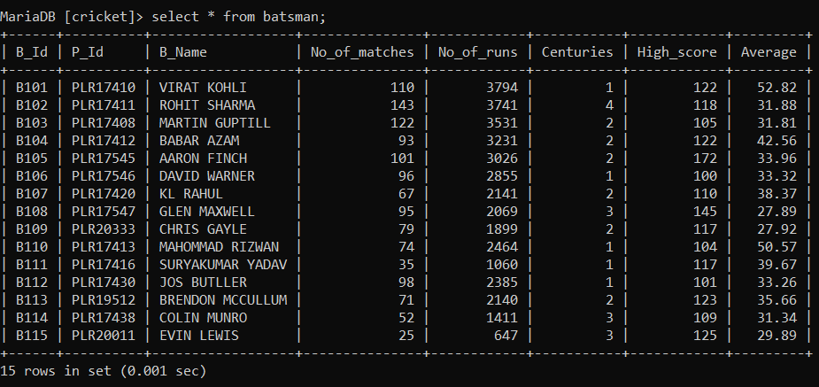
INSERT TABLE
BATSMAN

Slide 14
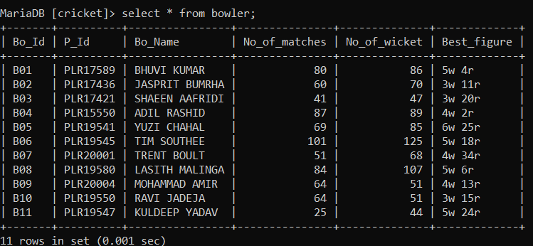
INSERT TABLE
BOWLER

Slide 15
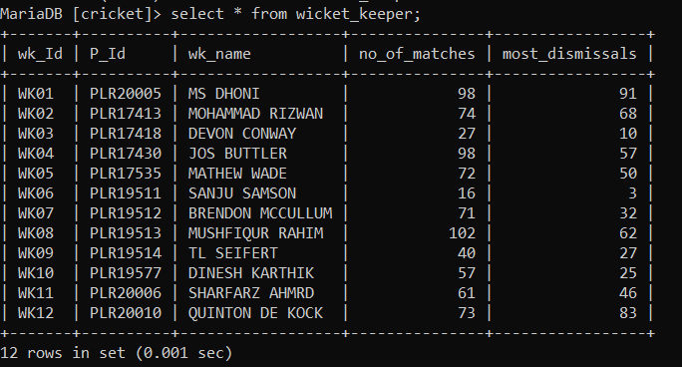
INSERT TABLE
WICKET KEEPER

Slide 16
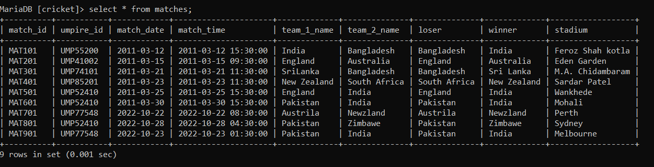
INSERT TABLE
MATCHES

Slide 17
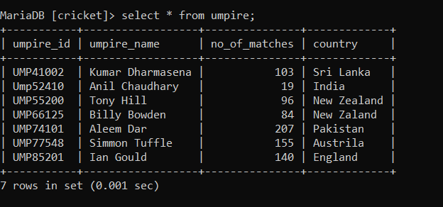
INSERT TABLE
UMPIRE

Slide 18
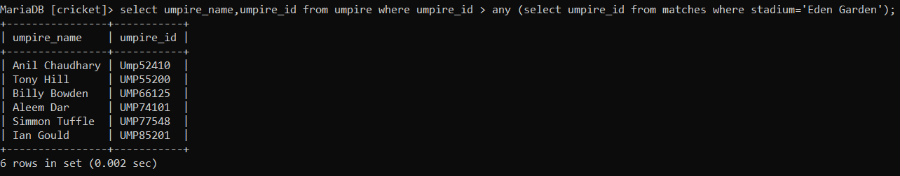
SUB QUERIES
Display the name of the umpires who have not umpired matches in Eden Gardens.

Slide 19
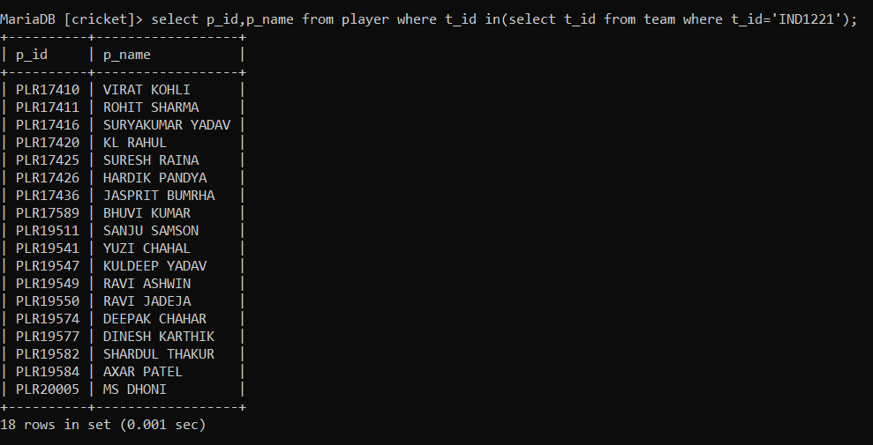
SUB QUERIES
Display the player Id and Name India Team from Player table.

Slide 20
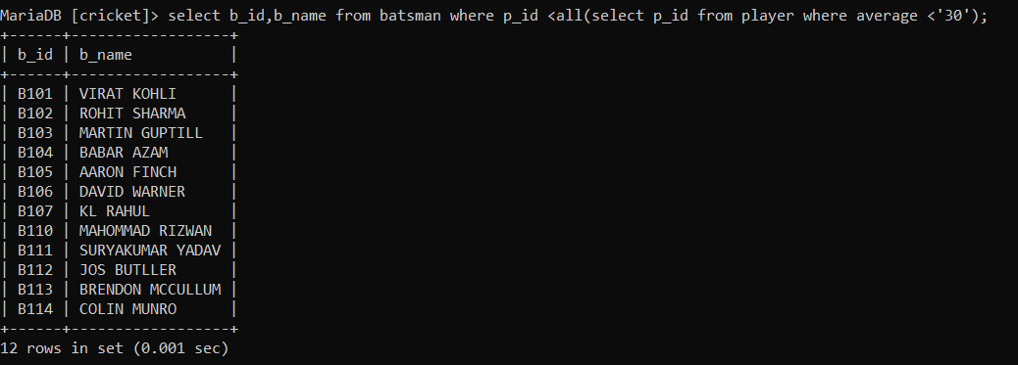
SUB QUERIES
Display batsman name with there average is > 30 from player table.

Slide 21
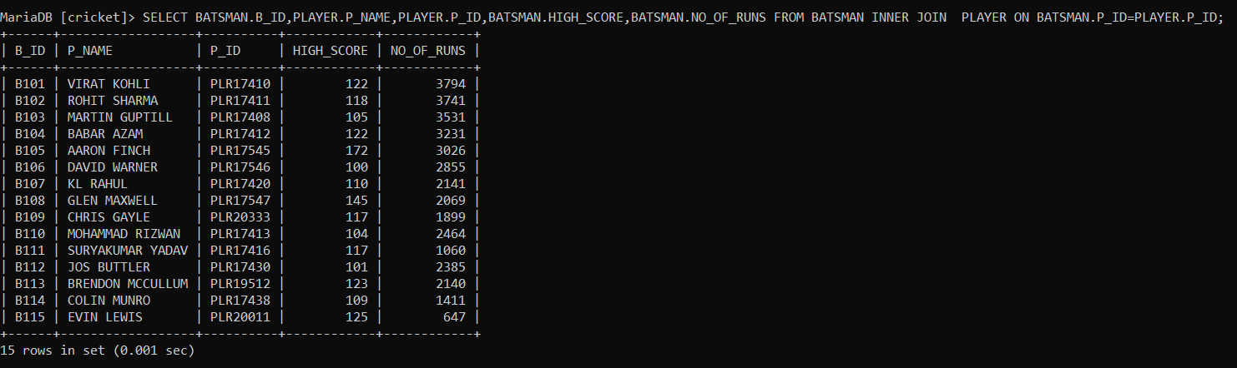
JOINS
INNER JOIN

Slide 22
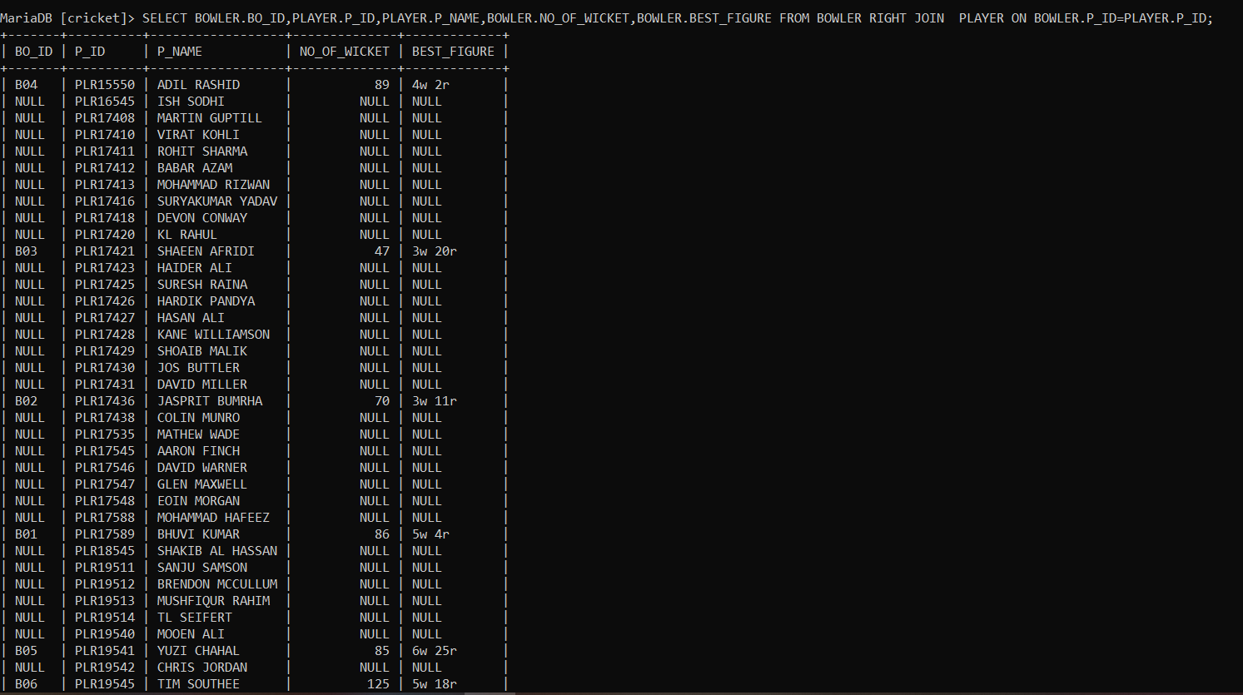
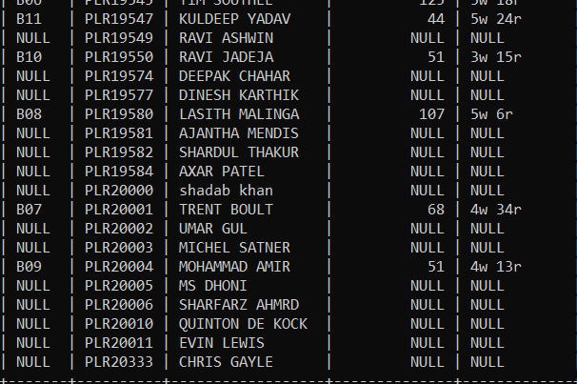
JOINS
RIGHT JOIN

Slide 23
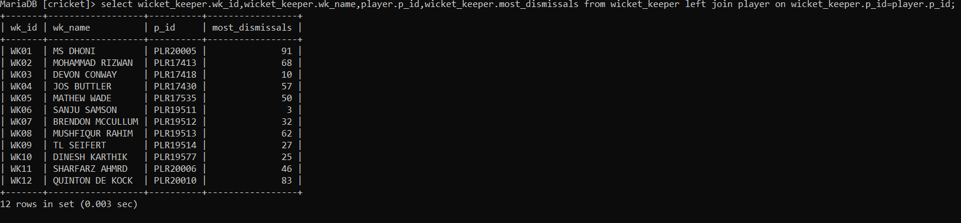
JOINS
LEFT JOIN

Slide 24
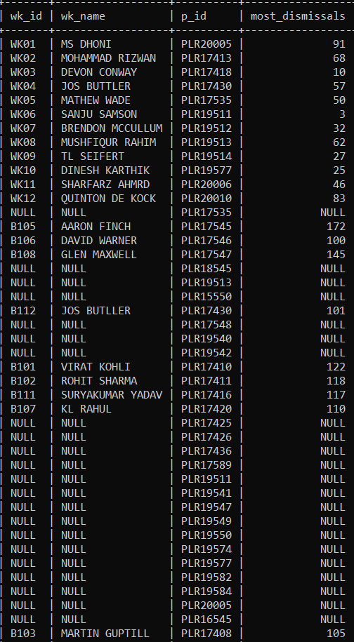
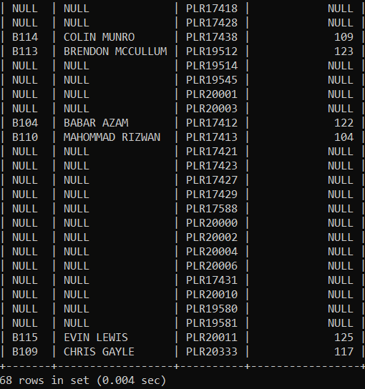
JOINS
select wicket_keeper.wk_id,wicket_keeper.wk_name,player.p_id,wicket_keeper.most_dismissals from wicket_keeper left join player on wicket_keeper.p_id=player.p_id UNION select batsman.b_id,batsman.b_name,player.p_id,batsman.high_score from batsman right join player on batsman.p_id=player.p_id;

Slide 25
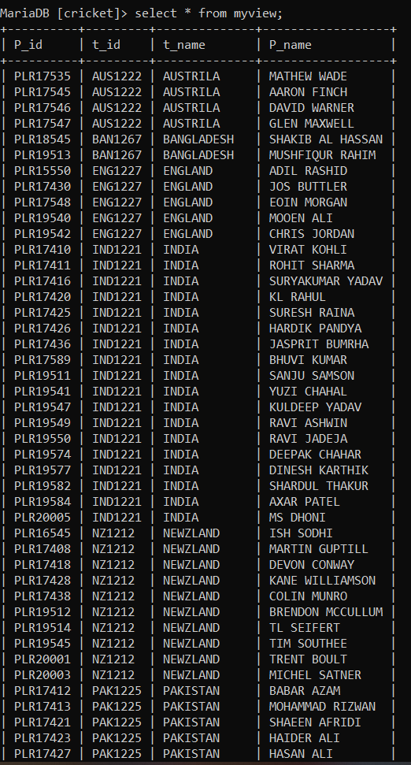
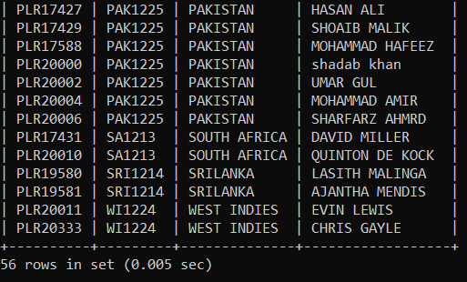
MULTIPLE TABLE VIEWS
create view myview as select player.P_id,team.t_id,team.t_name,player.P_name from player,team where team.t_id=player.t_id;

